Slide 1
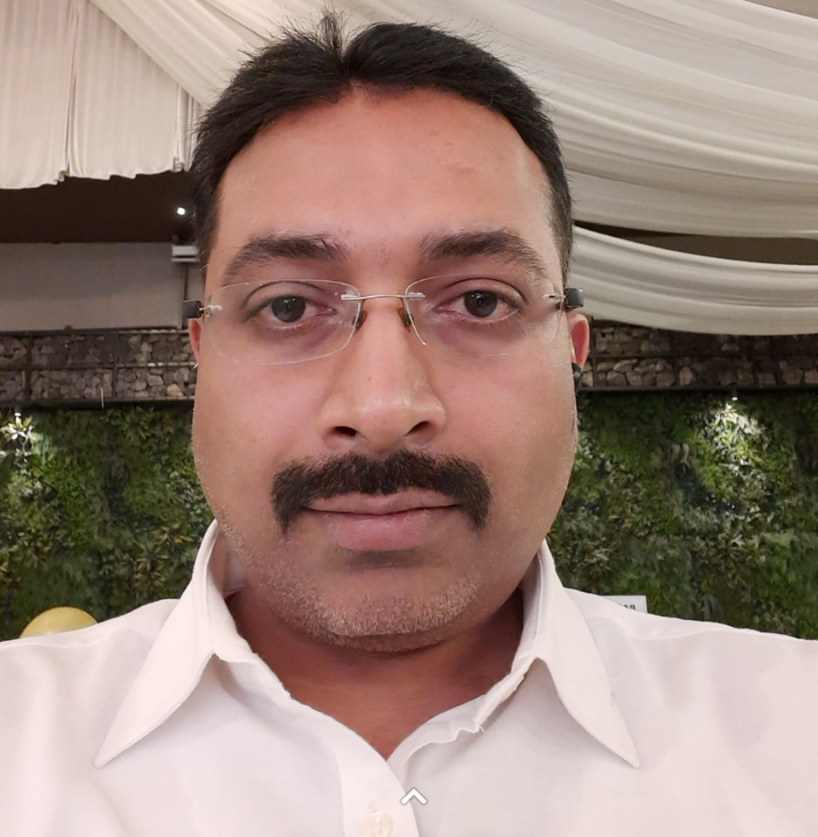


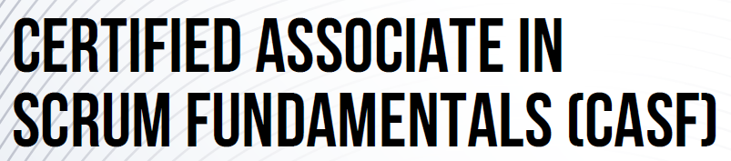
Professional Summary
Vivek Pradeep Kadam
Validation Lead (CSV + Functional)
Automation Testing: Playwright
API Testing: POSTMAN
Compliance-focused reviews
Defect & Incident Manager
Project Management Support & Coordination
Education:
Bachelor of Engineering in Computers
Diploma in Computer Technology
Certifications:
Core Skills:
Automation & Testing Tools
Playwright - TypeScript
POSTMAN API Testing
HP-ALM, JIRA, Azure DevOps (ADO)
Compliance & Quality Assurance
Defect & Incident Management
Root Cause Analysis
GxP Practices (Life Sciences)
Compliance-focused Reviews (CD/FDD/TDS)
Project & Process Management
Agile / SCRUM Methodologies
Project Monitoring & Reporting
Risk Management & Stakeholder Communication
Content Mgmt. Systems
Adobe Experience Manager (AEM)
Veeva Vault QMS
Soft Skills
Leadership & Collaboration
Negotiation & Conflict Resolution
Problem Solving & Execution
Contact details:
Vivek.Kadam@cognizant.com
+91 – 9850220482
Pune, India
Seasoned QA, Test Lead and CSV Lead with 18+ years of experience in software testing, quality assurance, and compliance-focused reviews across life sciences, banking, and digital platforms.
Skilled in leading cross-functional teams, managing stakeholder communication, and ensuring regulatory compliance under Agile/SCRUM methodologies.
Core expertise in gathering requirements, creating test plans, test estimations, developing test strategies, scheduling, resource planning, writing/review test scenarios and cases, maintaining a traceability matrix, preparing/maintaining test data, and producing testing progress and completion reports.
Recognized for driving efficiency, reducing defect leakage, and delivering high-quality releases through risk management, root cause analysis, and standardized testing practices.
Contributed towards design and implementation of a robust Test automation framework utilizing Playwright for functional testing and Applitool for visual validation, ensuring pixel-perfect UI consistency across browsers and devices.
Built the framework in TypeScript to enable strong typing, modular design, and a scalable, maintainable test architecture.
Contributed to design &implementation of automated API testing for Adobe Experience Manager (AEM) components using POSTMAN, creating smoke test suites to validate critical functionality after every build.
Projects Experience
Merck KGaA, Germany (CSV Test Lead, Automation Tester and Project Management Support & Coordination)
Performed Test Lead role for migration project involving 40k webpages into AEM framework.
Design and implementation of Test Automation Framework for webpage pixel by pixel validation.
Oversaw project monitoring, control, and reporting, ensuring smooth coordination among diverse stakeholders throughout the release cycle.
Performed compliance-focused reviews of CD/FDD/TDS documents.
Novo Nordisk Inc. USA (CSV Test Lead and Automation Tester) – Migration of AEM On-Prem to Cloud via Adobe AEM as Cloud Service. Handled a team of 18+ QA members involved in testing for AEM customized and OTS component used by developers and marketers to organize and distribute content across digital channels.
Boehringer Ingelheim, Germany (CSV Lead) – Migration from legacy to Veeva Systems in Data Migration, Interface and Process Config areas with GxP practices of Life Science industry. Handled team of 10+ QA members working in Veeva Vault QMS with below responsibilities in line with GxP practices of Life Science industry.
Credit Suisse Group AG (Test Analyst) - APAC Exchange connectivity team responsible for Order Routing, Exchange Link and Dark Pool (Internal Order Crossing Engine) & Smart Order Routing Systems.
Barclays Capital Inc. (Test Analyst) - Securities Lending, Collateral Allocation and Client Asset Utilization team.
Work Experience
Cognizant Technology Solutions, India Pvt. Ltd. – Senior associate (2011 to till date)
Atos india pvt. Ltd. – test analyst (2008 to 2011)
Virstra i-technology services ltd. – test engineer (2007 to 2008)

